Slide 1
Aura HRMS (Human Resource Management System)
404 Founders | Hackathon 2025

Slide 2

Problem Statement
Major HR Teams and Employee gaps:
HR teams often struggle with fragmented, manual, and disparate systems for managing the Employee Lifecycle (from onboarding to exit), leading to inefficiencies, errors in reporting, and compliance risks.
HR Major issues:
HR Managers/Generalists who spend excessive time on administrative tasks like generating Performance, Attendance, Payroll, and Training reports.
Employees in mid-to-large-sized organisations with complex, multi-site, or international workforces.
who lack a single, intuitive Employee Self-Service Portal for core HR needs.
Impacts of our solution:
The shift to hybrid/remote work necessitates better location-based attendance/holiday management and digital Asset Management.
Increased regulatory scrutiny demands rigorous HR Compliance Audit (HCA) and Contract Management System (CMS) tools.

Slide 3
Solution Overview
Our Solution:
Our solution is a unified, modular AI-Powered HRMS that centralises Employee Lifecycle Management (ELCM), reporting, and compliance into a single, intuitive platform.
Key features or technology involved:
Unified Reporting Suite: Includes Performance, Attendance, Turnover, Leave, Payroll, and Training reports with deep analytics.
Advanced Leave Management: Features customizable leave policies (Tailored leave policies), Location-based holidays (Automated holiday calendars), and Simplified approvals (Leave grants).
Compliance & Management Modules: Dedicated modules for HR Compliance Audit (HCA), Asset Management, and a robust Contract Management System (CMS) with renewal alerts.
Employee Engagement: Tools like Internal Customer Satisfaction Survey (ICSS) and Employee Satisfaction Survey.
Detailed Attendance: First in & last out Report (Early/Late entry), Shift Deviation Report, and various OT Reports.
Unique or innovative:
It combines traditionally separate functions (HRMS, HCA, CMS, and Asset Management) into one platform.
The depth of the reporting, especially in attendance (Shift Deviation, First in & last out), and the flexibility of customizable/location-based leave policies set it apart.

Slide 4

Desirability (User Need)
Target users
Primary: HR Leaders and Administrators (who need the reports, compliance, and policy control).
Secondary: All employees (who use the Employee Self-Service Portal and benefit from simplified leave).
Key buyer: CEO/CFO/COO (driven by compliance risk reduction and efficiency gains).
Pain point:
Eliminates the cost and complexity of integrating multiple software systems (HRIS, CMS, and Asset tracking).
Reduces the risk of non-compliance (via HCA and automated Contract renewal Alert).
Frees up HR time by automating complex reporting and policy application.
Testimonials or validation:
We will use the Internal Customer Satisfaction Survey (ICSS) framework built into our app to gather continuous feedback from users.

Slide 5
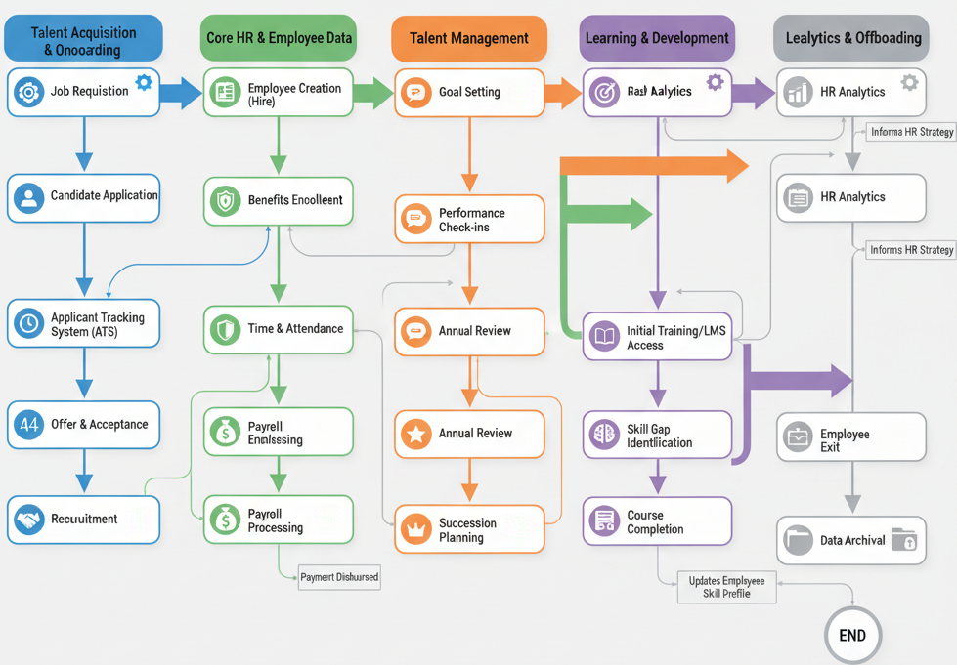
Feasibility (Can You Build It?)
Frontend:
React/Vue.js
Backend:
Node.js(Server)
Python(Django/Flask)
Express
Database:
PostgreSQL(Query storage)
Hosting:
AWS
Core Tech:
AI/ML for predictive turnover analysis
Limitations:
AWS subscriptions

Slide 6
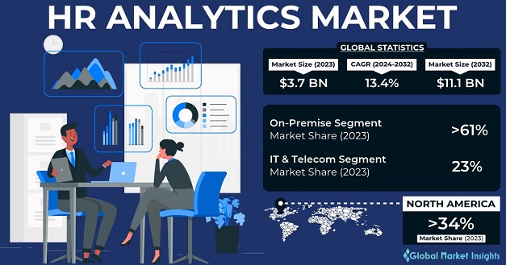
Viability (Is It Sustainable?)
Revenue model:
Subscription-based SaaS model. Tiered pricing based on the number of employees and the modules utilised (e.g., higher tier for HCA/CMS).
Target market size/demand.
The global HR Tech market is expected to reach between $69.6 billion and $88.38 billion by 2033.
Our focus is the mid-market segment (500-5000 employees) that needs enterprise features without the enterprise price tag.
Cost estimates/scalability potential.
Highly scalable due to cloud-native architecture. Server costs are the primary variable cost, which decreases per employee as the user base grows.

Slide 7
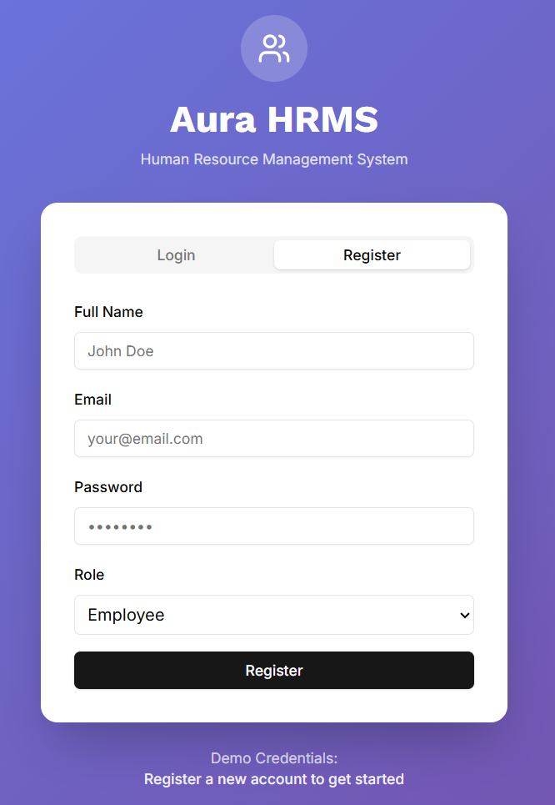
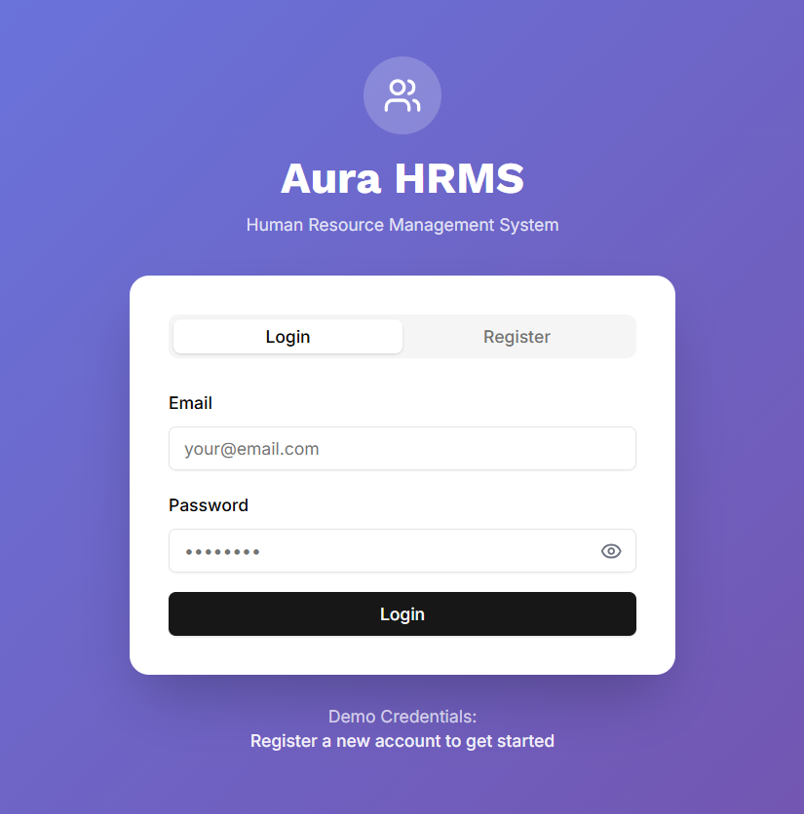
Prototype / Demo

Slide 8
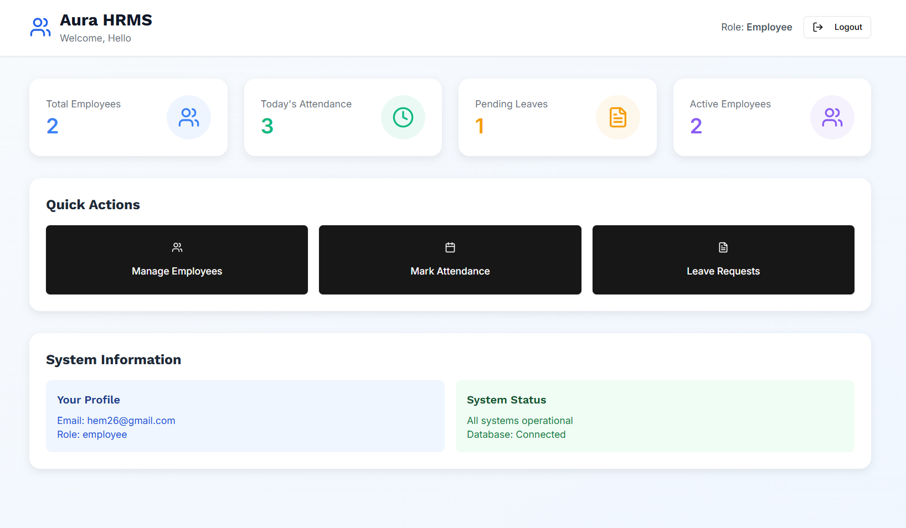
Prototype / Demo

Slide 9
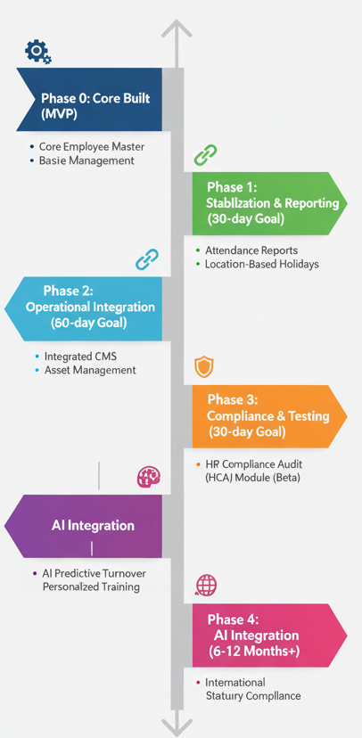
Roadmap
Core built:
The core Employee Master (Organisation, Department, Designation, etc.).
Basic functionality for the Employee Self-Service Portal and leave request.
Next plan:
30-day: Fully functional Attendance Reports and Location-based holidays.
60-day: Integrated Contract Management System (CMS) and Asset Management.
90-day: Beta launch of the HR Compliance Audit (HCA) module.
Long-term vision:
Integrate AI for predictive Turnover reports and personalised training recommendations.
Expand to support international statutory compliance.

Slide 10
Team & Roles
•Name | Role | Skill:
Vignesh L(Leader) | Front End Development | React, React native, JavaScript, Angular
Hemnath Singh K | Database | PostgreSQL, MongoDB
Rithick R | Back End Development | Express.js, Node.js, API development
Lokesh A | Hosting | version control systems, AWS, CI/CD, containerization (Docker, Kubernetes), Ansible
Thirumalai K | Testing | Selenium, JIRA
Background/credentials:
We have actively participated in multiple hackathons, gaining hands-on experience in rapid prototyping and collaborative development under pressure. Our collective portfolio includes projects that span AI-driven analytics, secure application development, and modern user interface design, providing a solid foundation for the ambitious scope.
Past Experience:
Our strength lies in our ability to integrate these complex technologies. We are not just five individual specialists but a cohesive unit capable of building a unified platform where AI, blockchain, and cloud services work together seamlessly.

Slide 11
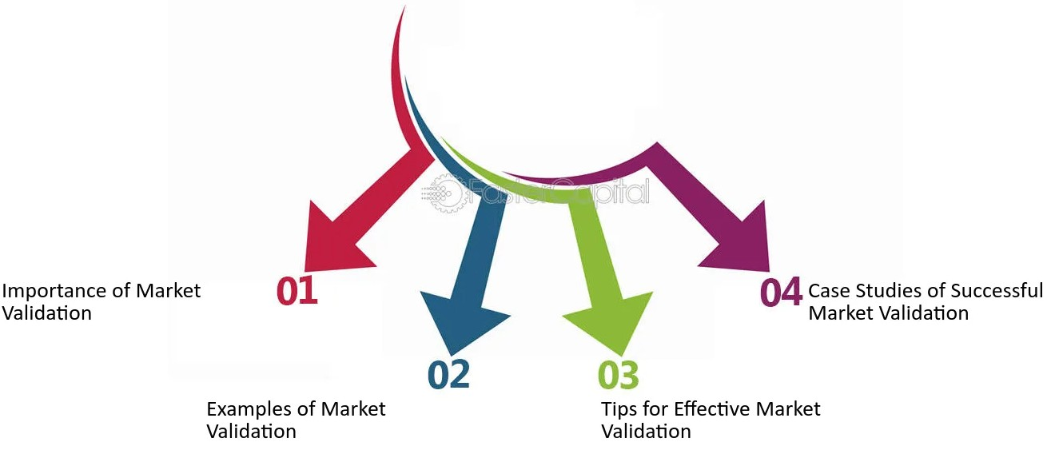
Ask
Our expectation from judges/audience:
Specific feedback on the integration points between HCA, CMS, and ELCM.
Funding, mentorship, feedback, partners:
We are seeking mentorship from HR tech veterans to refine our go-to-market strategy.
We are looking for beta partners (organisations of 500+ employees) to test the HCA module.

Slide 12
Thank You
Contact details:
Email:
vigneshsuba78@gmail.com
hemnathit302@gmail.com
rithickr2226@gmail.com
lokeshanbu08@gmail.com
thiruit303@gmail.com
LinkedIn: www.linkedin.com/in/vignesh-l-681156360
GitHub: https://github.com/VigneshLakshmanan0/
“Unify Your HR. Unlimit Your Potential”

